Slide 1
They Hunger from the satellites
Introducing…

Slide 2
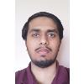
Muhammad Bilal
ERD Designer a.k.a. The Relationship Expert
Height: Average Weight: ??? Weapon of Choice: Long-barrel Rifle Special Trait: Established relationships with newly acquired data Goals: Find his place amongst the moon base Family: Safe on Earth
Muhammad joined the Technicians after establishing newfound data with already current research.

Slide 3
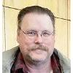
Drew jensen
Data Dictionary Visionary a.k.a The Mad Columnist
Height: Tall Weight: ??? Weapon of Choice: His mind and side arm pistol Special Trait: Constructed and retained our data dictionary Goals: Growth and success with the moon bases Family: Safe on Earth
Drew joined the Technicians after solidifying his knowledge with the data we almost lost.

Slide 4
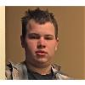
Caleb halvorson
Database Engineer a.k.a The Cog of Creation
Height: Average Weight: ??? Weapon of Choice: SMG/Pistol side-arm Special Trait: Operating and maintaining a structurally unsound database Goals: To survive the moon base operation Family: Located on LightSideB2 Basecamp
Caleb joined the Technicians after protecting and improving a stable data environment.

Slide 5

Joshua tiemens
Communicator
a.k.a. The Deranged Storyteller
Height: Tall Weight: ??? Weapon of Choice: Sniper Rifle Special Trait: Radio communications and unparallel stories to tell Goals: To write a book covering the events of this mission Family: Missing after DarkSide attack
Joshua impeded his position with the Technicians after establishing communications with Earth.

Slide 6
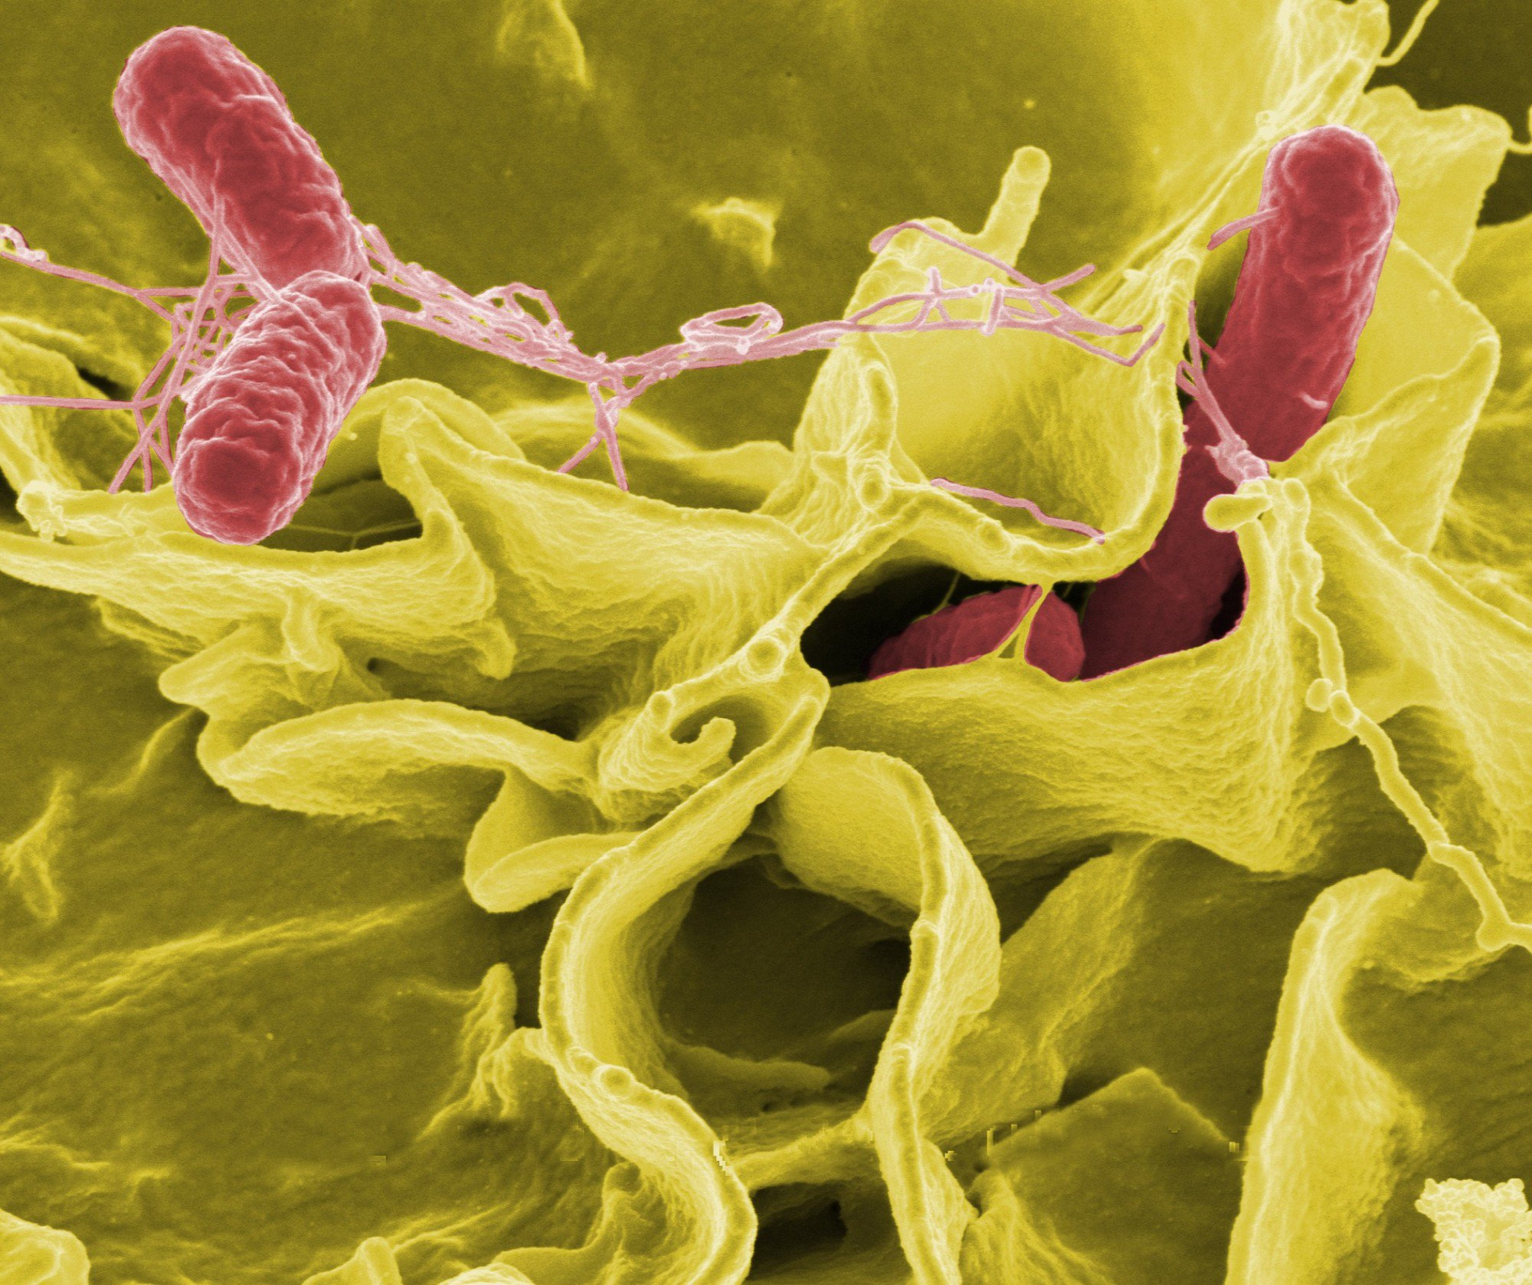
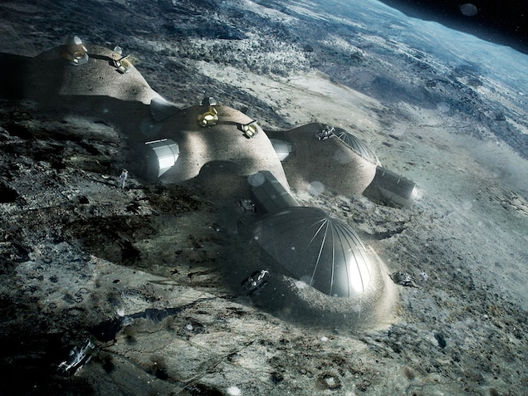
Events thus transpired(Joshua)
Venture to the dark side has proven dangerous
A foreign enemy we named The Demshi destroyed our technologies and data
Transportation to Earth was destroyed
Problematic disease turning humans into mindless, aggressive threats
Resources are compromised

Slide 7
Our main problem
How to survive an apocalyptic zombie-like infection while effectively quarantined on an isolated base on the Moon.
Solution A) Wait it out and survive by attrition – mainly supply routes and keep alive while the infection runs its course
Solution B) Wipe out all of the infected by ourselves without outside aid
Solution C) Develop an effective treatment (or even a cure) using limited available resources

Slide 8
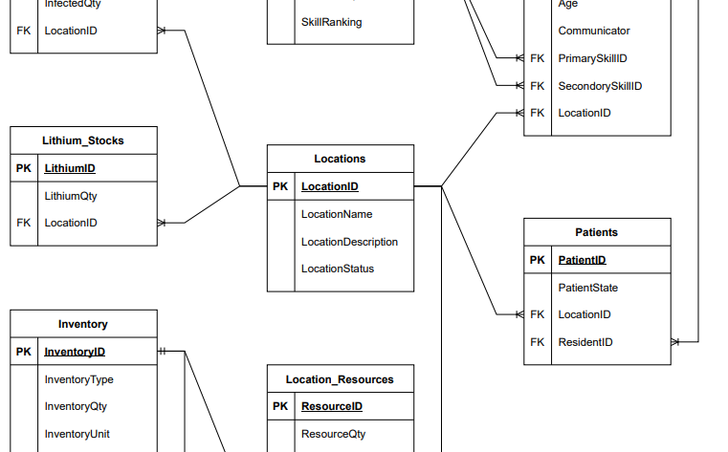
ERD design (Muhammad)
Keeping our relationships up to date and current
Producing accurate results of tracking
Constantly updating with new information provided
Maintaining unique keys to combine important data

Slide 9

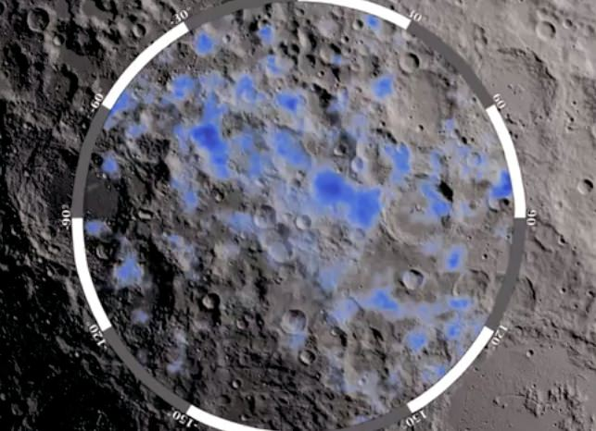
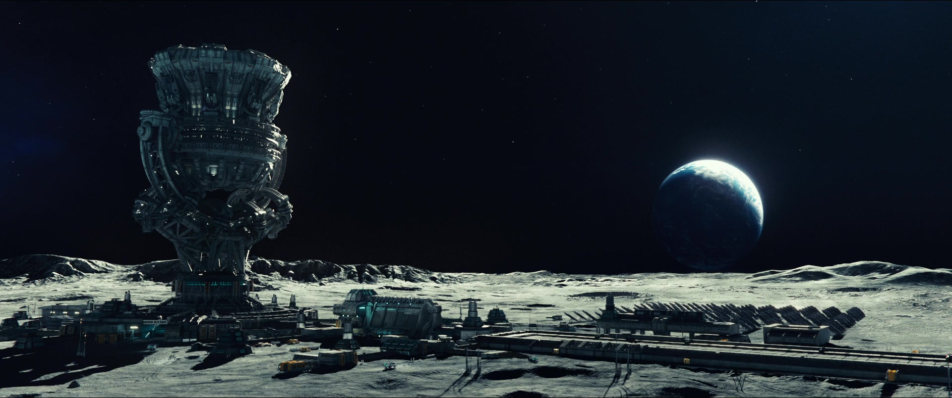
Our control on data (drew)
Our data originally tracked resources of production
Our goods had a consistent transfer rate
Productivity reports proved resource promise

Slide 10
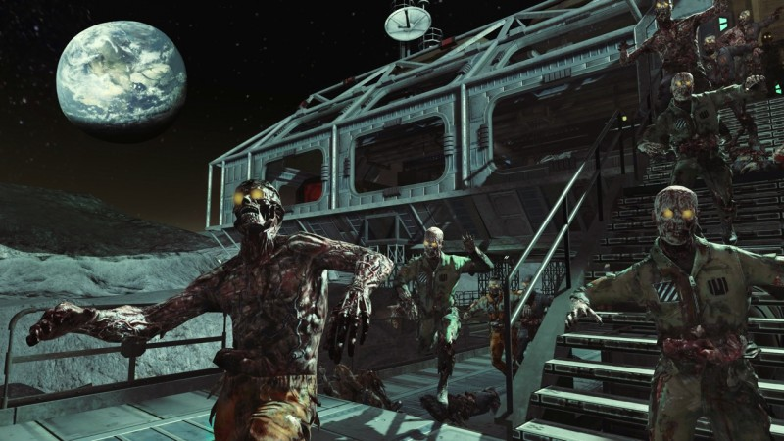
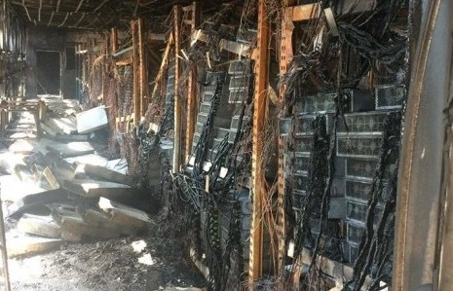

Our disaster (drew)
Majority of our systems have suffered great damage
Infected rate continues to grow, and vaccine studies haven’t progressed
Main mission is still a priority
Trade routes have reduced
Bases are being sieged by the infected

Slide 11
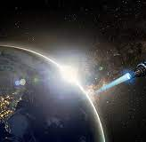
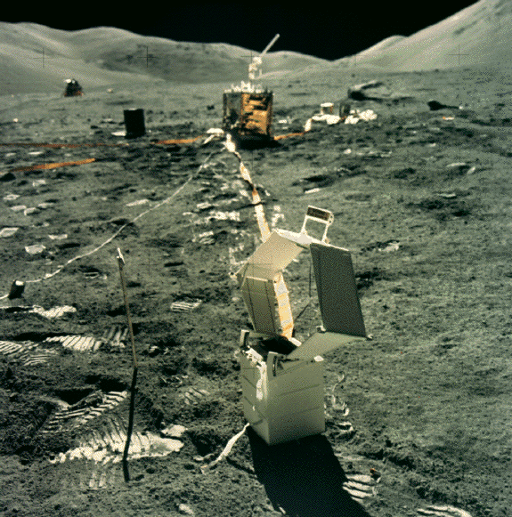
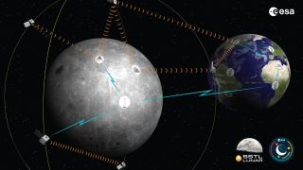
Our focus (drew)
Tracking infected and their attributes
Tracking resources
Tracking Miners, Growers, Scientists, and Military
Tracking base operations and hostile locations
Tracking colonists and skills
Population control

Slide 12
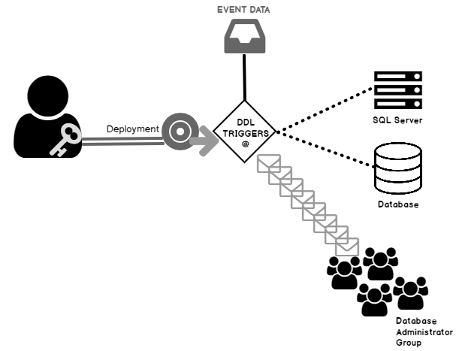
What makes you trigger? (caleb)

Slide 13
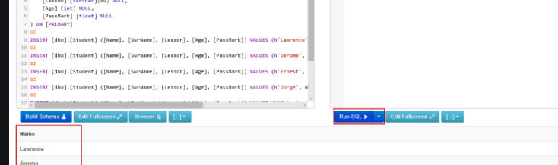

Query this (caleb)
What information matters
How to display what we need
Where does our strengths and weaknesses display
How strong is our data

Slide 14
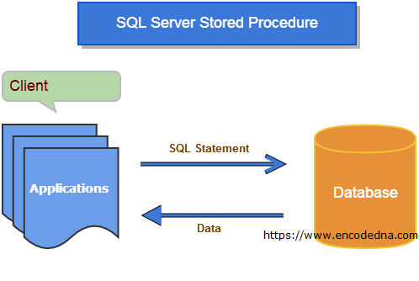
Storing our procedures (caleb)
Improving our design and procedures will produce rapid results and populate required data to consistently support our operations on the moon.
Our operations rely on the information we can transpire to our leaders.

Slide 15
Events to complete
Nov. 14 – Begin entering normalized data in selected tables: Finalize Phase One ERD; begin brainstorming queries
Nov. 21 – Develop query list and begin Phase One testing of database; Finish input of initial data load
Nov. 28 – Incorporate triggers and stored procedures; Finalize Phase One and develop critical steps for final Phase Two
Dec. 5 – Incorporate C# working front end for database; Last chance to make any structural changes
Dec. 12 – Run through working database (dress rehearsal) for Phase Two; Review what works and what doesn’t; Make final changes
Dec. 19 – Submit final project with results

Slide 16
Fulfillment roles
ERD/Structure Lead – Muhammad
Data Dictionary Lead – Drew
Project Wrangler/Submission Lead – Caleb
C# Front End Lead – Joshua
Prioritizes/Deadline Keeper – Muhammad
Quality Control/Data Entry Lead – Caleb
Archivist/Data Entry Second – Drew
Spokesperson/Solving the Problem Lead - Joshua

Slide 17
Group policies and practices
Utilize and rely on the group’s strengths that we’ve developed over the coming days
Maintain timely communication
Resolve disagreements democratically
Check each other’s work; share responsibility for getting it right
Wherever possible rely on previous examples of work for insight

